Slide 1

Project : The Restaurants Management Website
Submitted By :
Deepanshu
Roll No.: 192007
Sem.: 7th Sem.
Branch: C.S.E

Slide 2
Project Supervisor :
Ms. Prachi
(Assistant Professor of C.S.E. Dept.)
Mrs. Anju Godara
(Assistant Professor of C.S.E. Dept.)

Slide 3
About The Project :
The Leafy Bar Restaurants project is written in HTML, CSS & JavaScript.
The project File Contains a HTML, CSS & JavaScript Script.
The Leafy Bar Restaurants Contain 3 Html file : one for main page and other 2 for login & signup page.

Slide 4
Technology Used : HTML :
HTML stands for Hyper Text Markup Language
HTML is the standard markup language for creating Web pages
HTML describes the structure of a Web page

Slide 5
CSS:
CSS stands for Cascading Style Sheets
CSS describes how HTML elements are to be displayed on screen, paper, or in other media
CSS saves a lot of work. It can control the layout of multiple web pages all at once
External stylesheets are stored in CSS files

Slide 6
JavaScript:
JavaScript (js) is a light-weight object-oriented programming language which is used by several websites for scripting the webpages. It is an interpreted, full-fledged programming language that enables dynamic interactivity on websites when applied to an HTML document.

Slide 7
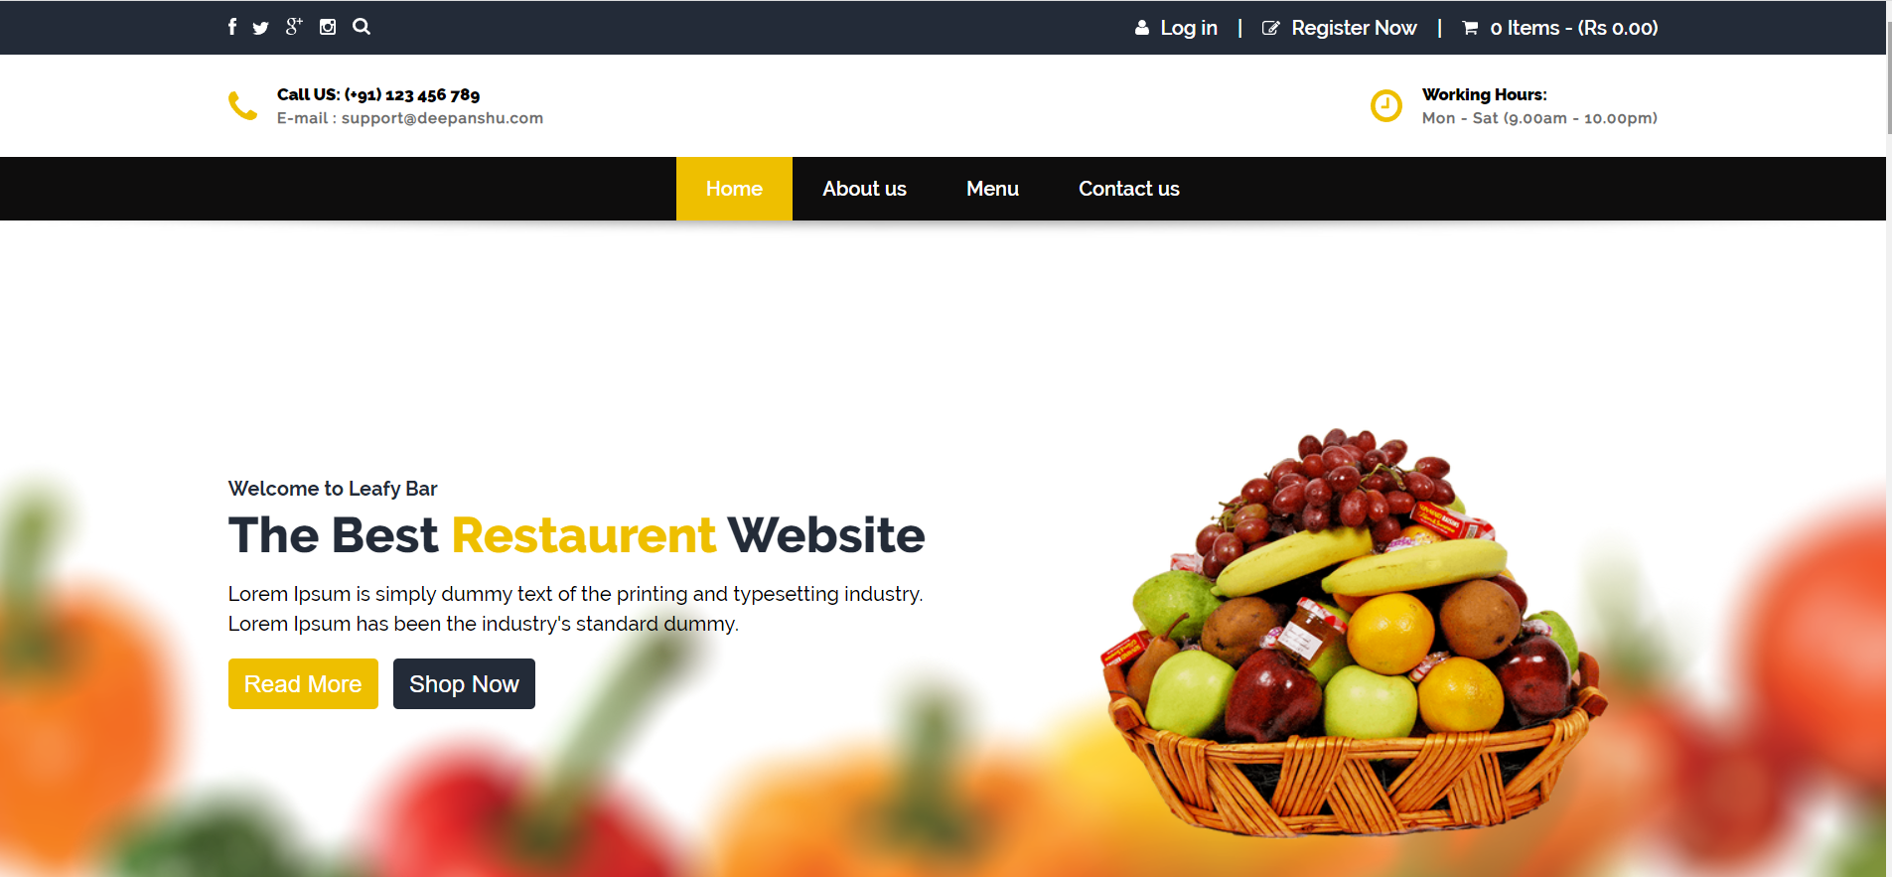
HOME PAGE :

Slide 8
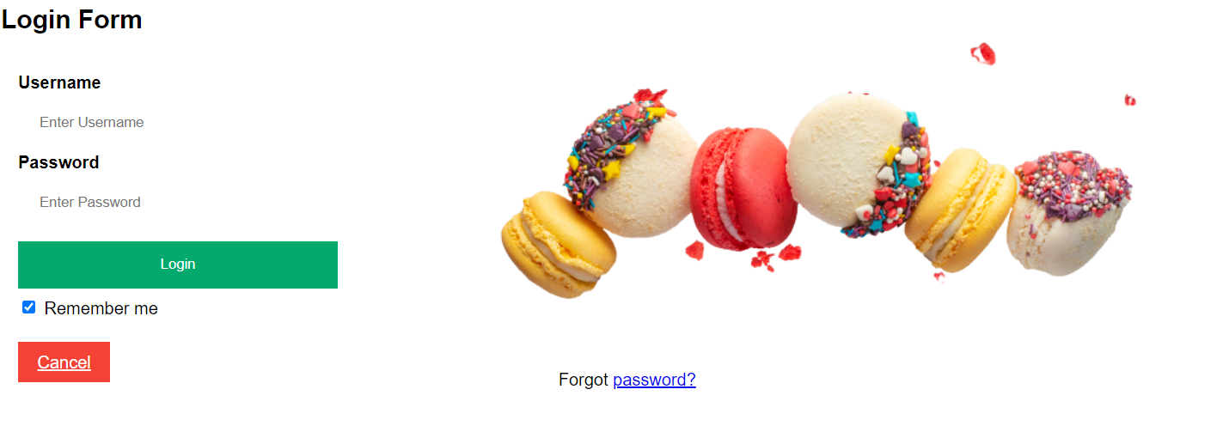
Login Page :

Slide 9
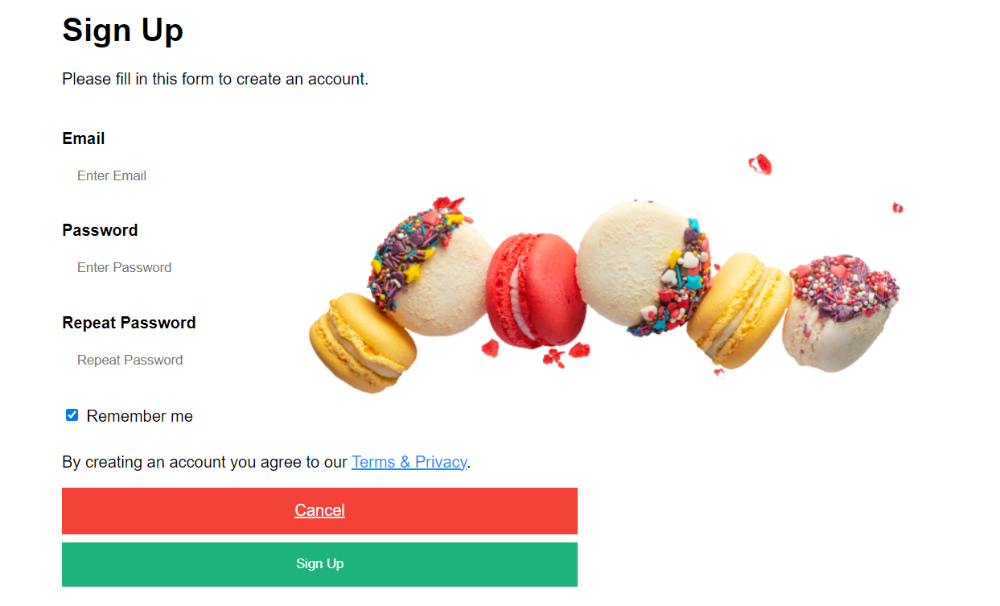
Sign Up Page :

Slide 10
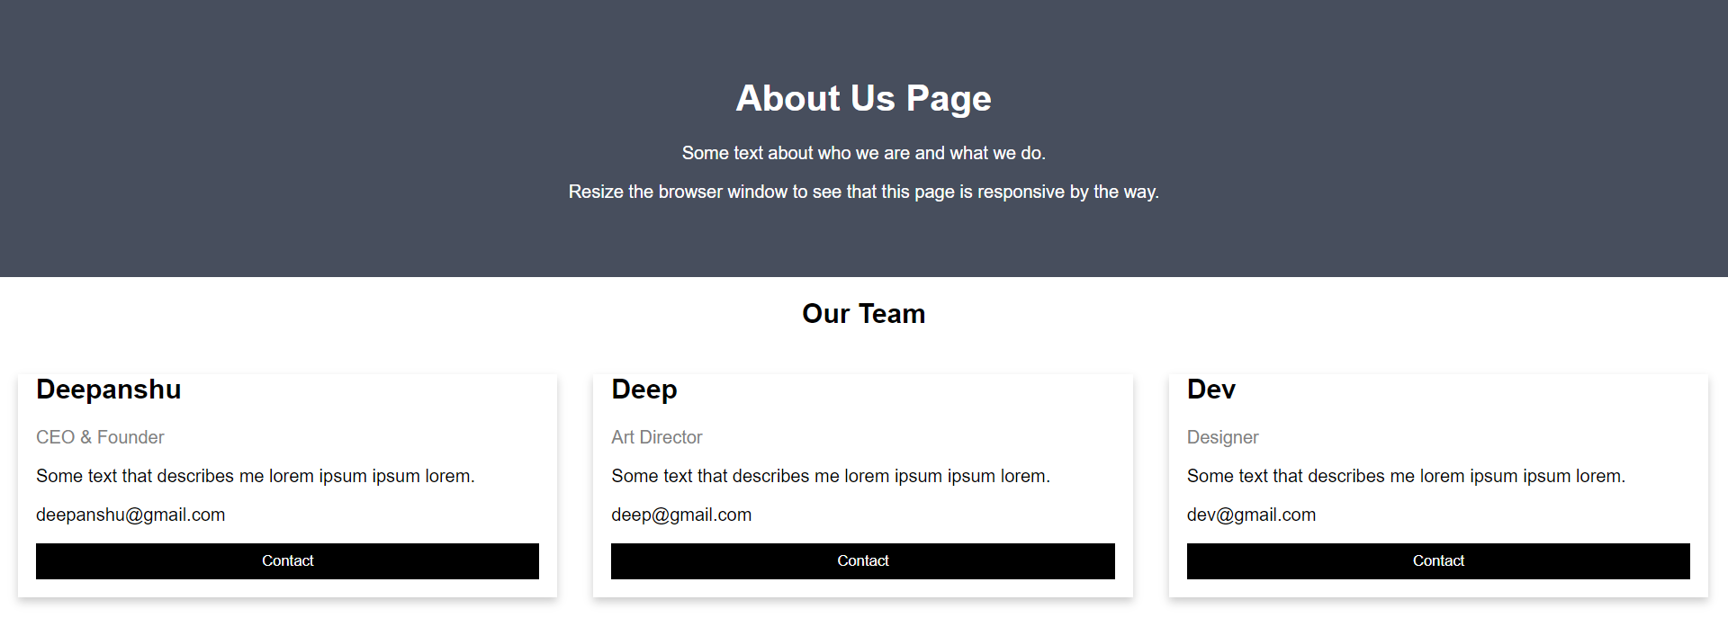
About Us :

Slide 11
Menu :

Slide 12
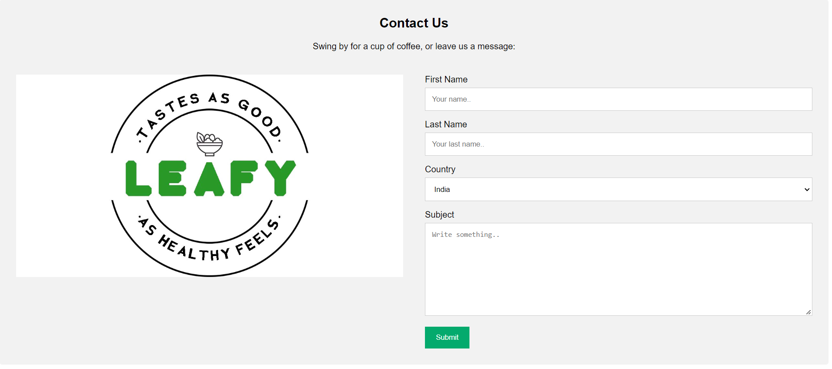
Contact Us:

